Slide 1
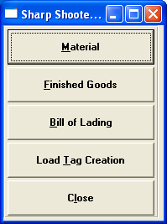
ADVANTZWARE
Sharp Shooter
Advanced Software
Corrugated Box, Folding Carton, Manufacturing and Distribution Software

Slide 2
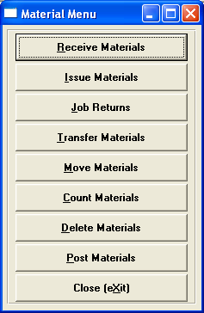
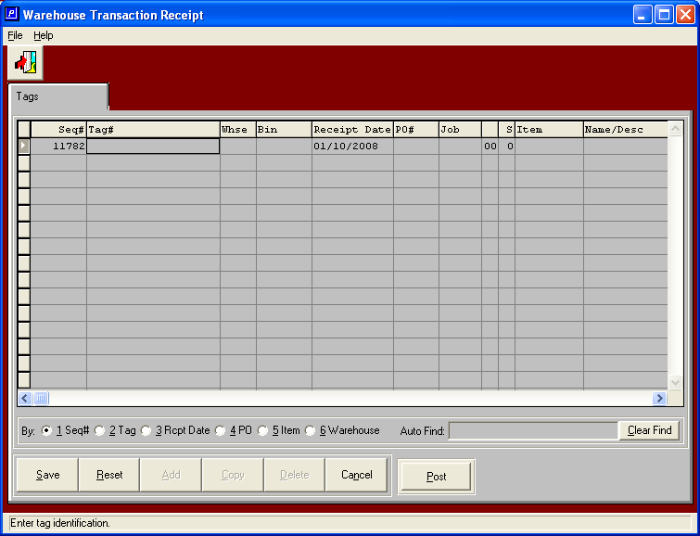
Raw Material Functions

Slide 3
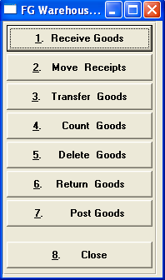
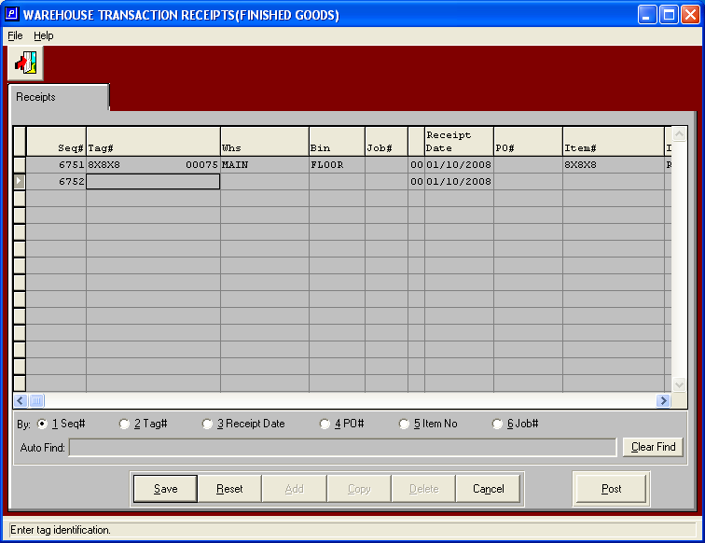
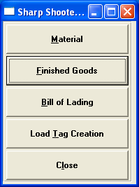
Finished Goods Functions

Slide 4
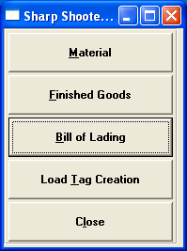
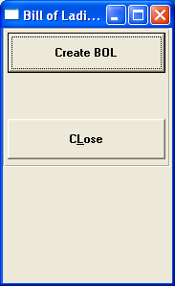
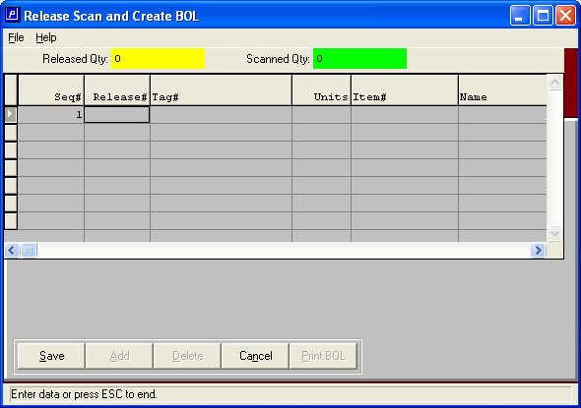
BOL Creation

Slide 5
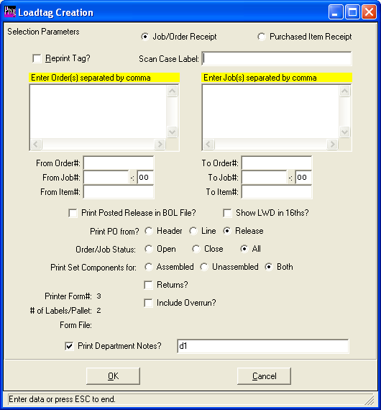
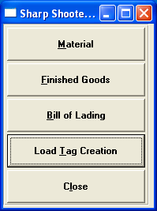
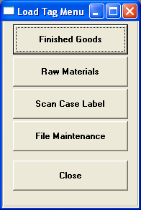
Load Tag Printing

Slide 6
Customer
Ord Reports
Advantzware - Flow
Estimate Cost Data
Ord History
Order Query
Load tags
Order Entry
Order Releases
BOM / Factory Tkt
From eCom
CAD-Spec
From RFQ
Estimating
Inventory Allocation
Product Spec
Quote History
Quotations
Job Cost
Production Job
Raw Matrl Inventory
Purchasing
Schl Brd
Touch Scrn
RF Bar Code
Line-up
Wk Sta Based
PO Receipts
Scheduling
Production Reporting
RF Bar Code
Accts Payable
WIP
FG Moves
FG Inv at Standard
Gen Ledger
RF Bar Code
BOL
Truck Loading
Accts Receivable
Invoicing
Sales History

Slide 7
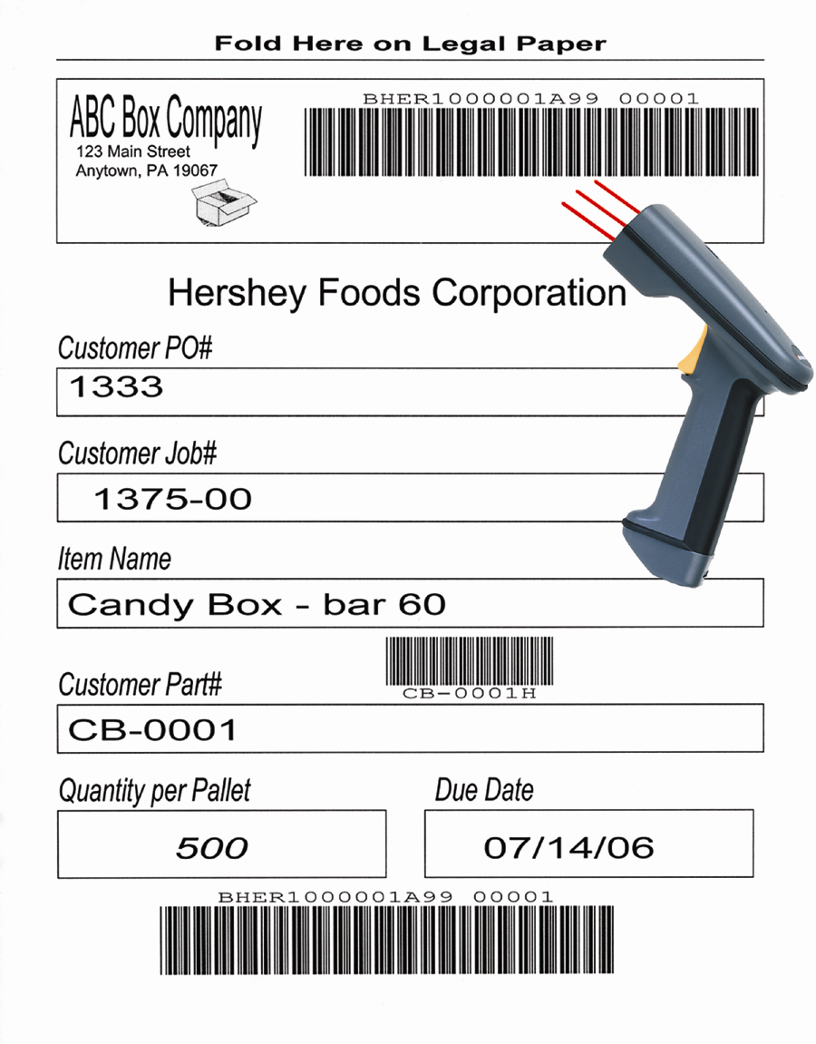
Touch Scrn
Wk Sta Based
Production Reporting
RF Bar Code
Functions:
RM receipts
Move into FG
Transfer to different bin
Transfer to different WH
Load truck
Create BOL
Take physical counts
WIP
FG Moves
FG Inv at Standard
RF Bar Code
BOL
Truck Loading

Slide 8
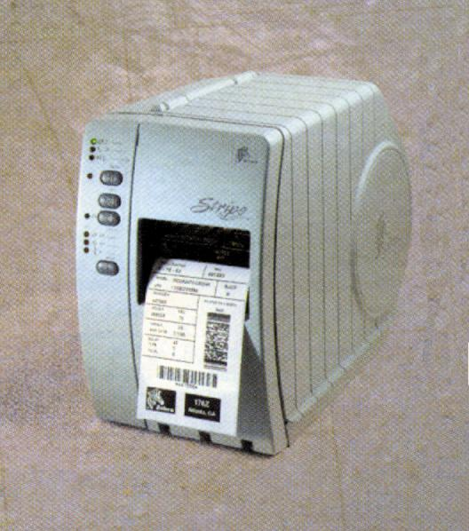
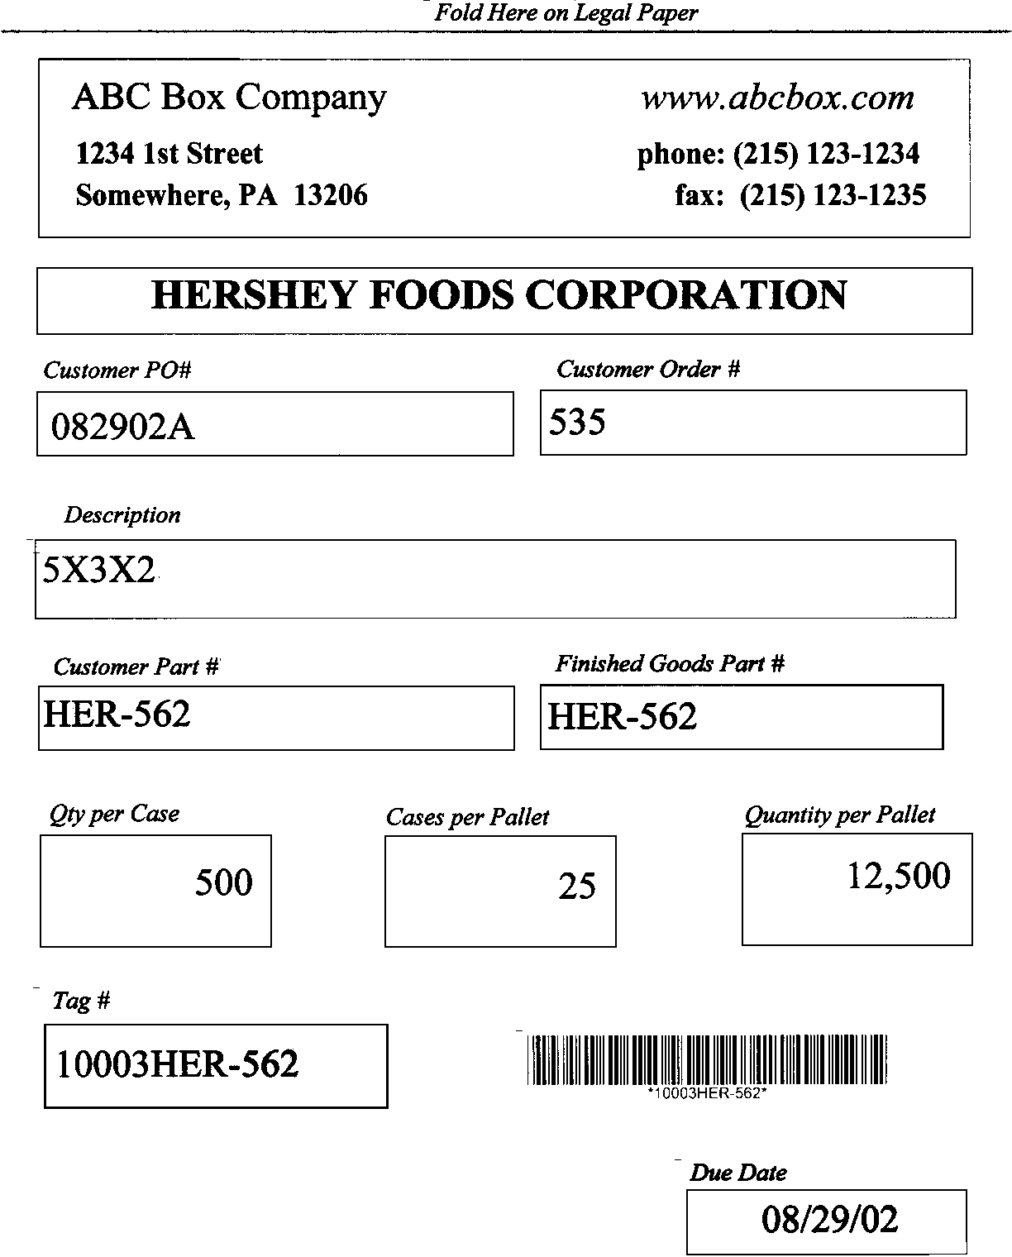
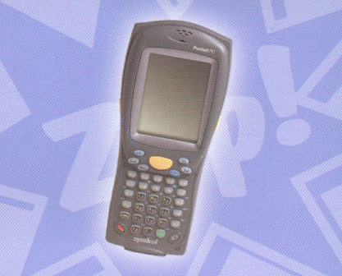
Advanced Software
Unique Bar Code Numbering
Once orders or jobs are created for finished goods, unique bar coded case labels and load tag numbers are generated for each pallet count.
When purchase orders for raw materials are received, the system automatically creates unique bar codes for each material part number for tracking inventory by tag number, job number, unit count, warehouse and bin location.

Slide 9
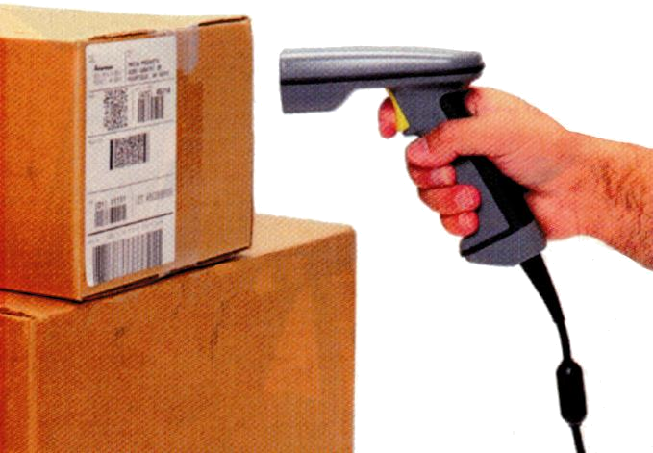
Advanced Software
Finished Goods Inventory
Plant data collect tracks the last machine operation and prompts for the tag numbers for receiving goods into on hand quantity. The tag number will store job number unit count and other pertinent finished goods and customer information. Warehouse transactions such as receipts, transfers, adjustment and physical counts are a simply scan of the pallet tag followed by a scan of the warehouse and bin.
Bills of Lading
The shipping process is streamlined via touch sensitive bill of lading transactions, which prompt to scan each bar coded pallet tag when loading onto the truck.
Purchase Orders Receiving
If the vendor supplies bar coded load tags, the radio frequency scanner simply shoots each bar code and bin location to receive each pallet load of material. Alternatively, the purchase order receipt logic will automatically down load information to print the load tags for all raw goods or finished goods that are on the purchase order. This will create a unique load tag with bar code number based on the unit counts received for each pallet or roll.

Slide 10
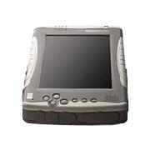
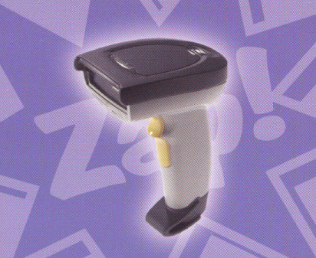

Advanced Software
Rugged Tablet PC, Pocket PC and Scanner provide easy
Bar Code Scanning via Radio Frequency Technology
Both devices provide wireless connection via radio frequency antennae throughout the plant or warehouse. Touch sensitive screens provide easy navigation throughout the software modules. Simply press menu option such as Receive, Move, Transfer, Delete or Count, then scan the load tag, scan the warehouse location and inventory is done.
Issues of materials to jobs will prompt to scan the job number, then scan the roll tags or pallet tags used in the production process. This will reduce inventory levels and update the work in process automatically.
Shipments via bill of lading requires a scan of the release ticket number followed by a scan of each pallet tag, then press the print button and your finished. Of course the system will prevent duplicate scans or incorrect inventory. In addition, discrepancies in quantity will automatically generate an email to the sales service department.

Slide 11
Advanced Software
Makefield Executive Quarters
301 Oxford Valley Road, Suite 1713
Yardley, PA 19067
Phone: (215) 369-7800
Fax: (215) 369-7801
e-mail: sales@advantzware.com
Call for a FREE Demo (215) 369-7800

